Slide 1
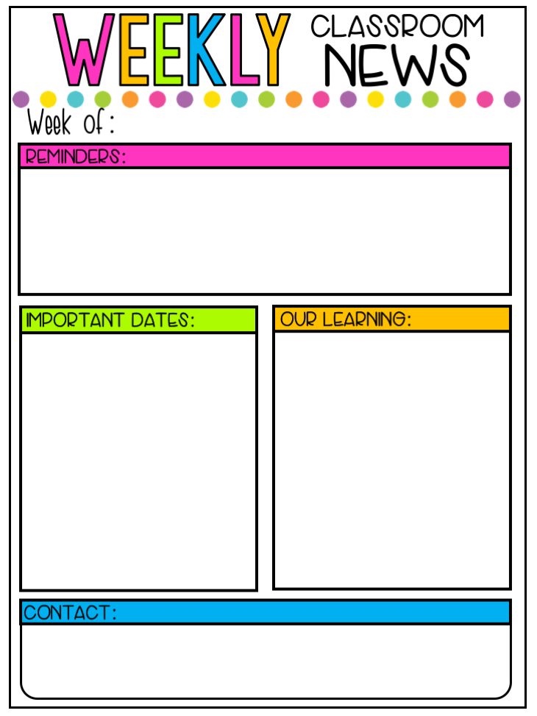
October 21, 2019 – Mrs. Millard’s Class
Specials
Monday: PE
Tuesday: ART
Wed.: No specials
Thursday: STEM
Friday: Music
Friday Treat
Oct. 25 – Lucas
Nov. 1– Case
Nov. 8 – Mitchell
Nov. 15 – Kellen
Nov. 22 – Thomas
*We have one nut allergy student and one gluten free student.
Language Arts/English:
Unit 1: Sentences & Word Order, Nouns, Verbs
Reading: Unit 2
*Sounds for Consonants and short vowels
*Types of genre
*Fiction/non-fiction
*Reading with Accuracy
*Print and Word Awareness
*Segmenting and Spelling Words
*Story Retelling
Writing:
*Letter sound dictation skills
*Sentence structure
*Beginning composition skills
*Writing a narrative
Math: Module 2: Addition and Subtraction with Teen Totals
Story Problems with Teen Total
Make a Ten Strategy for Addition with Teen Totals
October 23- Breast Cancer Awareness Day/Wear Pink with Uniform Bottom.
October 25 – $1.00 Dress Down
Red Ribbon Kick OFF/ Wear Red
October 28-Nov 1--Red Ribbon
Week
October 28-Fovorite Sports Jersey
October 29- Crazy Socks Day
October 30- Crazy Hat Day
October 31- Book Character Day
Nov 8-Progress Reports
Nov 11 –No School
Nov 18 –Nov 22: Fall Book Fair
Chanda.millard@sccpss.com
mrsmillard1stgrade@weebly.com
CLASS DOJO
Monthly Character Traits:
Oct. – Responsibility – TBA

Slide 2
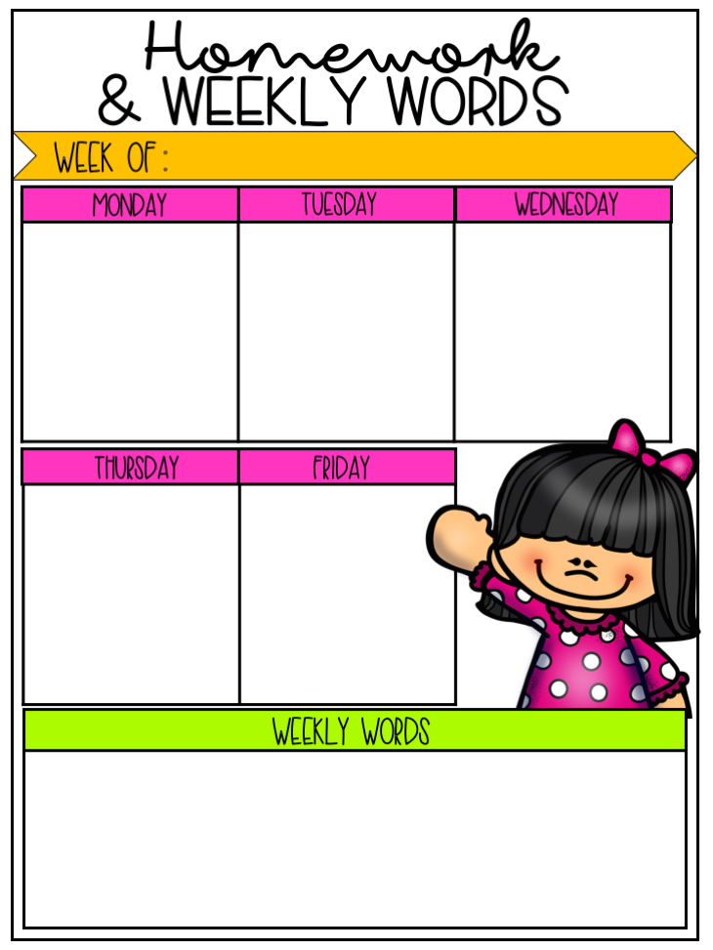
October 21, 2019
Reading: Fluency Folder
Math: Eureka Math Lesson 6
Zearn Math
Reading: Fluency Folder
Math: Eureka Math Lesson
Zearn Math
Reading: Fluency Folder
Math: Zearn
Reading: Fluency Folder
Math: Eureka Practice – Lesson 8
Fluency Folders should be turned in every Friday.
*embarc.online is a great website resource for Eureka Math.*
Phonics Unit 5
In Fundations Unit 5, students work with the glued sounds –all as in ball, -am as in ham, and –an as in fan. In addition to the trick words taught previously, students must also read, write and spell these trick words:
TRICK WORDS (Sight Words)
from - have - do - does

